Slide 1
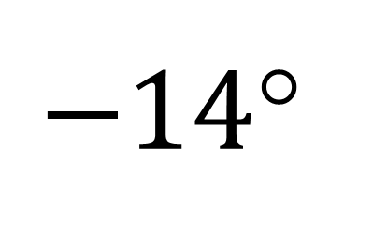
$−14$°
t = 5 s

